Slide 1
Able to develop the real time scenarios based on Node JS applications.
Notes:
Title - The learning outcome
Subtitle - Duration

Slide 2
In this section, we will discuss:
Type Script Datatype & Operator
Type Script String & Tuple, Oops
Object & Class
Inheritance & Interface
Angular js Child Component
Angular js Data Binding, Event Binding,2 Way Binding
Notes:
Mention the parent topics one by one. This particular learning outcome has 4 parent topics.

Slide 3
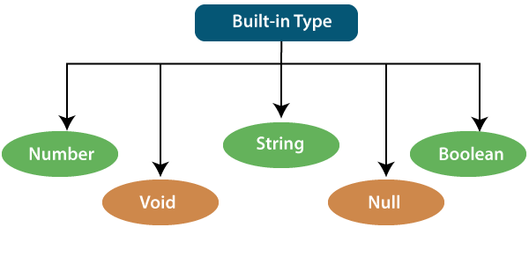
Type Script Datatype & Operator
Type Script Datatype
Whenever a variable is created, the intention is to assign some value to that variable but what type of value can be assigned to that variable is dependent upon the datatype of that Variable.
In typeScript, type System represents different types of datatypes which are supported by TypeScript.
Image Source:https://static.javatpoint.com/tutorial/typescript/images/typescript-types2.png
Notes:
Left (White Color space):
Title - Parent Topic
Subtitle - Subtopic 1
Body Text - Description in bullets
Right (Grey Color Space):
Body Text - Relevant image (with source)/code snippet
Put reference links in Speaker Notes
Reference:
https://www.tutorialspoint.com/internet_technologies/internet_overview.htm/

Slide 4
Type Script Datatype & Operator
Type Script Datatype
TypeScript has some pre-defined data-types
Number
Boolean
String
Void
Null
Image Source:https://static.javatpoint.com/tutorial/typescript/images/typescript-types2.png
Notes:
Left (White Color space):
Title - Parent Topic
Subtitle - Subtopic 1
Body Text - Description in bullets
Right (Grey Color Space):
Body Text - Relevant image (with source)/code snippet
Put reference links in Speaker Notes
Reference:
https://www.tutorialspoint.com/internet_technologies/internet_overview.htm/

Slide 5
Type Script Datatype & Operator
Number Datatype
Just like JavaScript, TypeScript supports number data type.
All numbers are stored as floating-point numbers.
These numbers can be Decimal (base 10), Hexadecimal (base 16) or Octal (base 8).
Image Source:https://static.javatpoint.com/tutorial/typescript/images/typescript-types2.png
Notes:
Left (White Color space):
Title - Parent Topic
Subtitle - Subtopic 1
Body Text - Description in bullets
Right (Grey Color Space):
Body Text - Relevant image (with source)/code snippet
Put reference links in Speaker Notes
Reference:
https://www.tutorialspoint.com/internet_technologies/internet_overview.htm/

Slide 6
Type Script Datatype & Operator
Boolean Datatype
Boolean values are supported by both JavaScript and TypeScript and stored as true/false values.
The upper-case Boolean is an object type whereas lower case boolean is a primitive type.
Image Source:https://static.javatpoint.com/tutorial/typescript/images/typescript-types2.png
Notes:
Left (White Color space):
Title - Parent Topic
Subtitle - Subtopic 1
Body Text - Description in bullets
Right (Grey Color Space):
Body Text - Relevant image (with source)/code snippet
Put reference links in Speaker Notes
Reference:
https://www.tutorialspoint.com/internet_technologies/internet_overview.htm/

Slide 7
Type Script Datatype & Operator
String Datatype
String is another primitive data type that is used to store text data.
String values are surrounded by single quotation marks or double quotation marks.
Image Source:https://static.javatpoint.com/tutorial/typescript/images/typescript-types2.png
Notes:
Left (White Color space):
Title - Parent Topic
Subtitle - Subtopic 1
Body Text - Description in bullets
Right (Grey Color Space):
Body Text - Relevant image (with source)/code snippet
Put reference links in Speaker Notes
Reference:
https://www.tutorialspoint.com/internet_technologies/internet_overview.htm/

Slide 8
Type Script Datatype & Operator
Void Datatype
Similar to languages like Java, void is used where there is no data.
For example, if a function does not return any value then you can specify void as return type.
There is no meaning to assign void to a variable, as only null or undefined is assignable to void.
Image Source:https://static.javatpoint.com/tutorial/typescript/images/typescript-types2.png
Notes:
Left (White Color space):
Title - Parent Topic
Subtitle - Subtopic 1
Body Text - Description in bullets
Right (Grey Color Space):
Body Text - Relevant image (with source)/code snippet
Put reference links in Speaker Notes
Reference:
https://www.tutorialspoint.com/internet_technologies/internet_overview.htm/

Slide 9
Type Script Datatype & Operator
Null Datatype
TypeScript has a powerful system to deal with null or undefined values.
Null and undefined are primitive types and can be used like other types, such as string.
Image Source:https://static.javatpoint.com/tutorial/typescript/images/typescript-types2.png
Notes:
Left (White Color space):
Title - Parent Topic
Subtitle - Subtopic 1
Body Text - Description in bullets
Right (Grey Color Space):
Body Text - Relevant image (with source)/code snippet
Put reference links in Speaker Notes
Reference:
https://www.tutorialspoint.com/internet_technologies/internet_overview.htm/

Slide 10

Typescript Operator
What is Typescript Operator
In TypeScript, an operator can be classified into the following ways:
Arithmetic Operators
Comparison (Relational) Operators
Logical Operators
Bitwise Operators
Assignment Operators
Ternary/Conditional Operator
Concatenation Operator
Type Operators
Image Source: https://discoversdkcdn.azureedge.net/postscontent/typeScript/operators in typescript.png
Notes:
This slide talks about the case if we have to divide a subtopic further.
Title Box - Parent Topic
Subtitle box - Sub Topic
Body Text - Subtopic divisions (Subtopics of subtopics)

Slide 11

What is Typescript Operator
Arithmetic Operators
Arithmetic operators take numeric values as their operands, performs an action, and then returns a single numeric value.
The most common arithmetic operators are addition (+), subtraction (-), multiplication (*), and division (/).
Image Source:https://www.tektutorialshub.com/wp-content/uploads/2020/09/Arithmetic-Operators-in-Typescript.jpg
Notes:
This slide talks about the case if we have to divide a subtopic further.
Title Box - Parent Topic
Subtitle box - Sub Topic
Body Text - Subtopic divisions (Subtopics of subtopics)

Slide 12
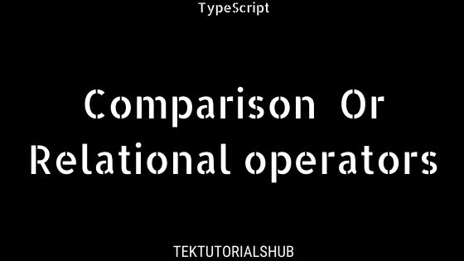
What is Typescript Operator
Comparison Operators
The comparison operators are used to compares the two operands.
These operators return a Boolean value true or false.
Image Source: https://www.tektutorialshub.com/wp-content/uploads/2020/09/Comparison-or-relational-operators-in-Typescript.jpg
Notes:
This slide talks about the case if we have to divide a subtopic further.
Title Box - Parent Topic
Subtitle box - Sub Topic
Body Text - Subtopic divisions (Subtopics of subtopics)

Slide 13
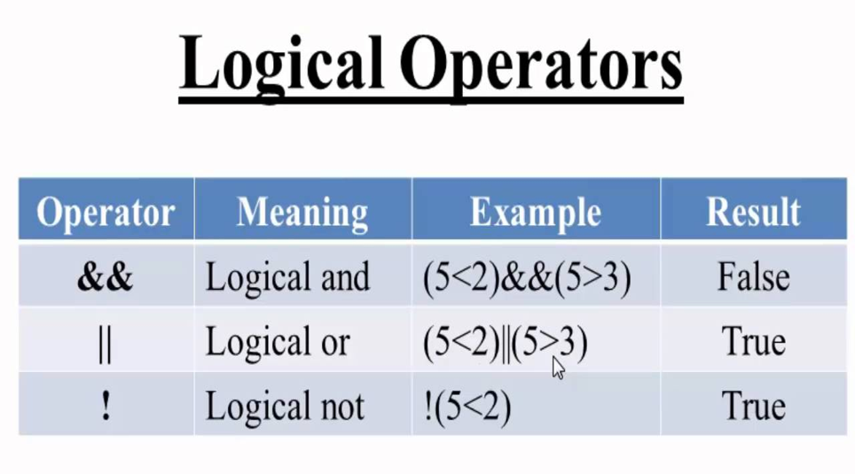
What is Typescript Operator
Logical Operators
Logical operators are used for combining two or more condition into a single expression and return the Boolean result true or false.
Image Source: http://enlightsolution.com/wp-content/uploads/2019/07/logical-operator.png
Notes:
This slide talks about the case if we have to divide a subtopic further.
Title Box - Parent Topic
Subtitle box - Sub Topic
Body Text - Subtopic divisions (Subtopics of subtopics)

Slide 14
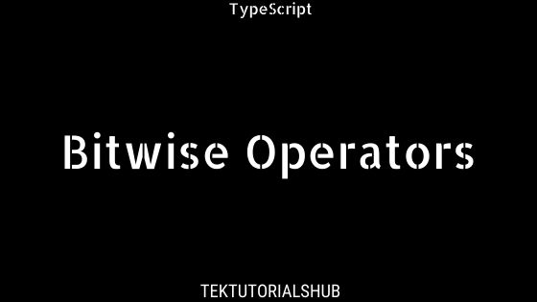
What is Typescript Operator
Bitwise Operators
The bitwise operators perform the bitwise operations on operands.
Image Source:https://www.tektutorialshub.com/wp-content/uploads/2020/09/Bitwise-Operators-in-Typescript.jpg
Notes:
This slide talks about the case if we have to divide a subtopic further.
Title Box - Parent Topic
Subtitle box - Sub Topic
Body Text - Subtopic divisions (Subtopics of subtopics)

Slide 15
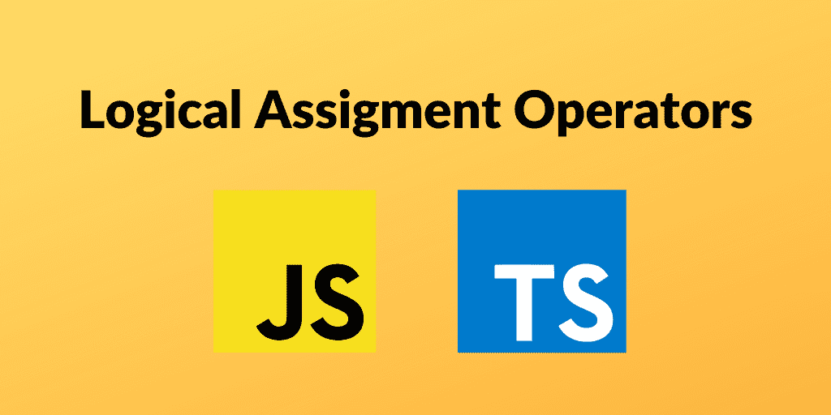
What is Typescript Operator
Assignment Operators
Assignment operators are used to assign a value to the variable.
The left side of the assignment operator is called a variable, and the right side of the assignment operator is called a value.
The data-type of the variable and value must be the same otherwise the compiler will throw an error.
Image Source: https://www.carlrippon.com/static/94667e436c1a793603017f278ad70724/26df7/banner.png
Notes:
This slide talks about the case if we have to divide a subtopic further.
Title Box - Parent Topic
Subtitle box - Sub Topic
Body Text - Subtopic divisions (Subtopics of subtopics)

Slide 16
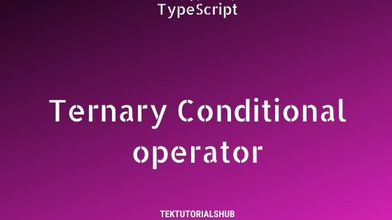
What is Typescript Operator
Ternary/Conditional Operators
The conditional operator takes three operands and returns a Boolean value based on the condition, whether it is true or false.
Its working is similar to an if-else statement.
The conditional operator has right-to-left associativity.
Image Source:https://www.tektutorialshub.com/wp-content/uploads/2020/09/Ternary-Conditional-operator-in-Typescript.jpg
Notes:
This slide talks about the case if we have to divide a subtopic further.
Title Box - Parent Topic
Subtitle box - Sub Topic
Body Text - Subtopic divisions (Subtopics of subtopics)

Slide 17
What is Typescript Operator
Concatenation Operators
The concatenation (+) operator is an operator which is used to append the two string.
In concatenation operation, we cannot add a space between the strings.
We can concatenate multiple strings in a single statement.
Image Source: https://discoversdkcdn.azureedge.net/postscontent/typeScript/operators in typescript.png
Notes:
This slide talks about the case if we have to divide a subtopic further.
Title Box - Parent Topic
Subtitle box - Sub Topic
Body Text - Subtopic divisions (Subtopics of subtopics)

Slide 18
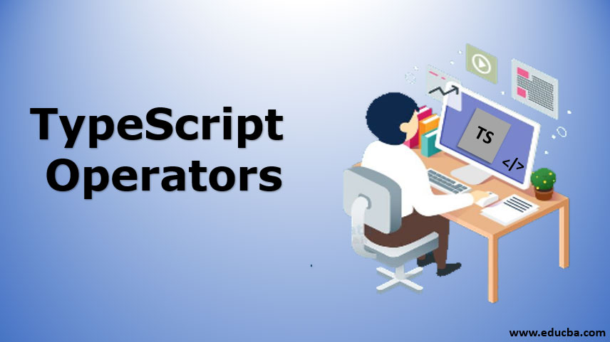
What is Typescript Operator
Type Operators
There are a collection of operators available which can assist you when working with objects in TypeScript.
Operators such as typeof, instanceof, in, and delete are the examples of Type operator.
Image Source:https://cdn.educba.com/academy/wp-content/uploads/2019/12/typescript-operators1.jpg
Notes:
This slide talks about the case if we have to divide a subtopic further.
Title Box - Parent Topic
Subtitle box - Sub Topic
Body Text - Subtopic divisions (Subtopics of subtopics)

Slide 19
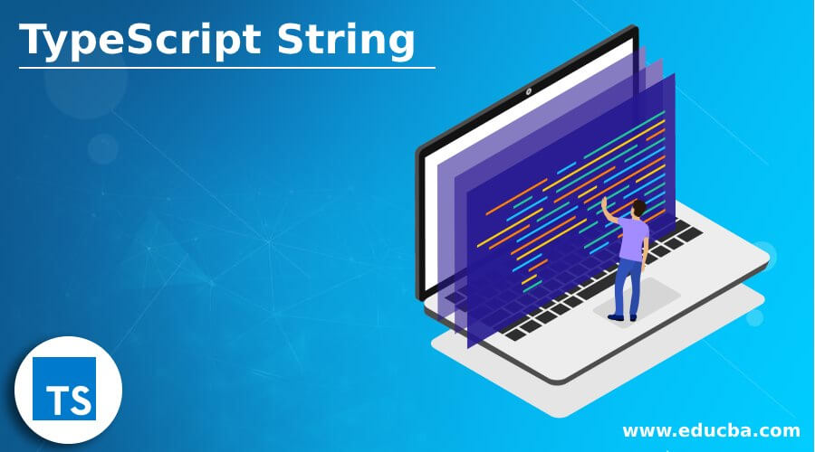
Type Script String & Tuple, Oops
TypeScript String
In TypeScript, the string is an object which represents the sequence of character values.
It is a primitive data type which is used to store text data.
The string values are surrounded by single quotation mark or double quotation mark.
An array of characters works the same as a string.
Image Source:https://cdn.educba.com/academy/wp-content/uploads/2021/01/TypeScript-String.jpg
Notes:
This slide talks about the case if we have to divide a subtopic further.
Title Box - Parent Topic
Subtitle box - Sub Topic
Body Text - Subtopic divisions (Subtopics of subtopics)

Slide 20
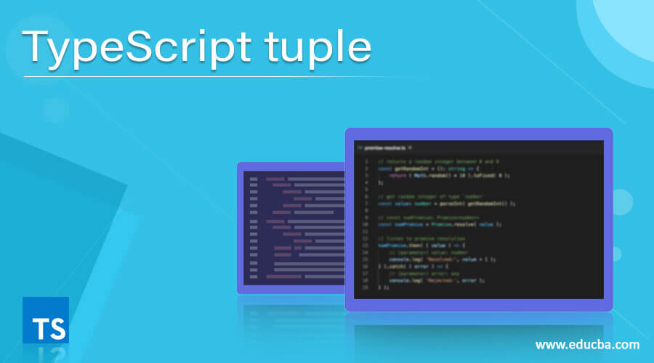
Type Script String & Tuple, Oops
TypeScript Tuple
A tuple is a data type which can be used like any other variables.
It represents the heterogeneous collection of values and can also be passed as parameters in a function call.
Image Source:https://cdn.educba.com/academy/wp-content/uploads/2020/12/TypeScript-tuple.jpg
Notes:
This slide talks about the case if we have to divide a subtopic further.
Title Box - Parent Topic
Subtitle box - Sub Topic
Body Text - Subtopic divisions (Subtopics of subtopics)

Slide 21
TypeScript Tuple
Accessing tuple Elements
We can read or access the fields of a tuple by using the index, which is the same as an array.
In Tuple, the index starts from zero.
Image Source:https://cdn.educba.com/academy/wp-content/uploads/2020/12/TypeScript-tuple.jpg
Notes:
This slide talks about the case if we have to divide a subtopic further.
Title Box - Parent Topic
Subtitle box - Sub Topic
Body Text - Subtopic divisions (Subtopics of subtopics)

Slide 22
Type Script String & Tuple, Oops
Operations on Tuple
A tuple has two operations:
Push()
Pop()
Image Source:https://cdn.educba.com/academy/wp-content/uploads/2020/12/TypeScript-tuple.jpg
Notes:
This slide talks about the case if we have to divide a subtopic further.
Title Box - Parent Topic
Subtitle box - Sub Topic
Body Text - Subtopic divisions (Subtopics of subtopics)

Slide 23
Type Script String & Tuple, Oops
Operations on Tuple
A tuple has two operations:
Push(): The push operation is used to add an element to the tuple.
Pop(): The pop operation is used to remove an element from the tuple.
Image Source:https://cdn.educba.com/academy/wp-content/uploads/2020/12/TypeScript-tuple.jpg
Notes:
This slide talks about the case if we have to divide a subtopic further.
Title Box - Parent Topic
Subtitle box - Sub Topic
Body Text - Subtopic divisions (Subtopics of subtopics)

Slide 24
TypeScript Tuple
Update or Modify the Tuple Elements
Tuples are mutable, which means we can update or change the values of tuple elements. To modify the fields of a Tuple, we need to use the index of the fields and assignment operator.
Image Source:https://cdn.educba.com/academy/wp-content/uploads/2020/12/TypeScript-tuple.jpg
Notes:
This slide talks about the case if we have to divide a subtopic further.
Title Box - Parent Topic
Subtitle box - Sub Topic
Body Text - Subtopic divisions (Subtopics of subtopics)

Slide 25
TypeScript Tuple
Clear the fields of a Tuple
We cannot delete the tuple variable, but its fields could be cleared.
To clear the fields of a tuple, assign it with an empty set of tuple field
Image Source:https://cdn.educba.com/academy/wp-content/uploads/2020/12/TypeScript-tuple.jpg
Notes:
This slide talks about the case if we have to divide a subtopic further.
Title Box - Parent Topic
Subtitle box - Sub Topic
Body Text - Subtopic divisions (Subtopics of subtopics)

Slide 26
Type Script String & Tuple, Oops
Typescript OOPS
Object Oriented Programming or OOP is a programming paradigm that has four principles which are:
Inheritance,
Abstraction,
Polymorphism,
And Encapsulation.
Image Source:https://cdn.educba.com/academy/wp-content/uploads/2021/01/TypeScript-String.jpg
Notes:
This slide talks about the case if we have to divide a subtopic further.
Title Box - Parent Topic
Subtitle box - Sub Topic
Body Text - Subtopic divisions (Subtopics of subtopics)

Slide 27
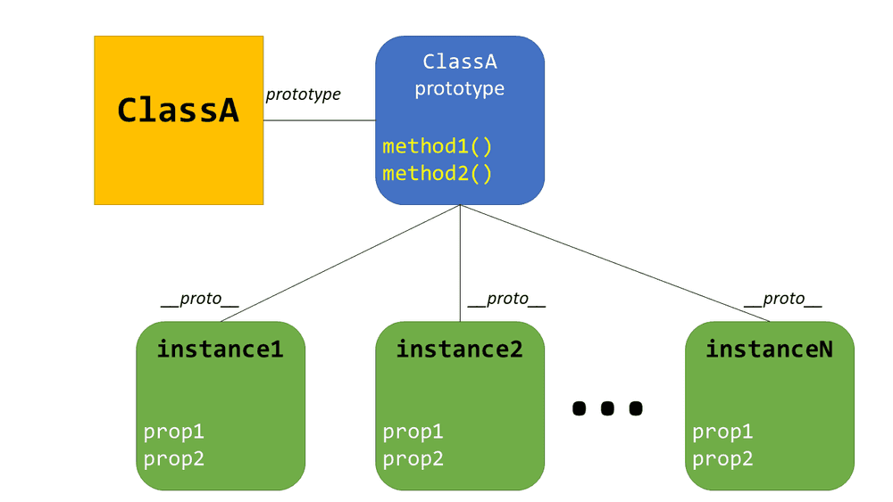
Object and Classes
Creating classes
Use the class keyword to declare a class in TypeScript. The syntax for the same is given below −
Syntax
class class_name {
//class scope
}
Image Source: https://instil.co/static/bbc9de35a7b1d565aaec5974bd860ed5/00d43/Prototype.png
Notes:
This slide talks about the case if we have to divide a subtopic further.
Title Box - Parent Topic
Subtitle box - Sub Topic
Body Text - Subtopic divisions (Subtopics of subtopics)

Slide 28
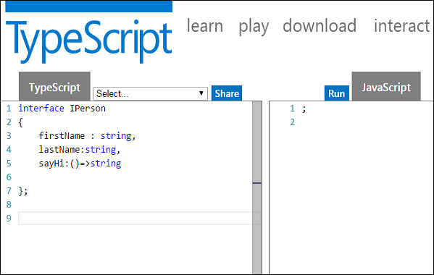
Inheritance & Interface
What is Interfaces & Inheritance
An interface can be extended by other interfaces.
In other words, an interface can inherit from other interface.
Typescript allows an interface to inherit from multiple interfaces.
Image Source:https://www.tutorialspoint.com/typescript/images/interface_and_objects.jpg
Notes:
This slide talks about the case if we have to divide a subtopic further.
Title Box - Parent Topic
Subtitle box - Sub Topic
Body Text - Subtopic divisions (Subtopics of subtopics)

Slide 29
Inheritance & Interface
What is Interfaces & Inheritance
Single Interface Inheritance
Multiple Interface Inheritance
Image Source:https://www.tutorialspoint.com/typescript/images/interface_and_objects.jpg
Notes:
This slide talks about the case if we have to divide a subtopic further.
Title Box - Parent Topic
Subtitle box - Sub Topic
Body Text - Subtopic divisions (Subtopics of subtopics)

Slide 30
Inheritance & Interface
Single Interface Inheritance
Syntax:
Child_interface_name extends super_interface_name
Image Source:https://www.tutorialspoint.com/typescript/images/interface_and_objects.jpg
Notes:
This slide talks about the case if we have to divide a subtopic further.
Title Box - Parent Topic
Subtitle box - Sub Topic
Body Text - Subtopic divisions (Subtopics of subtopics)

Slide 31
Inheritance & Interface
Single Interface Inheritance
Syntax:
Child_interface_name extends super_interface1_name,
super_interface2_name,…,super_interfaceN_name
Image Source:https://www.tutorialspoint.com/typescript/images/interface_and_objects.jpg
Notes:
This slide talks about the case if we have to divide a subtopic further.
Title Box - Parent Topic
Subtitle box - Sub Topic
Body Text - Subtopic divisions (Subtopics of subtopics)

Slide 32
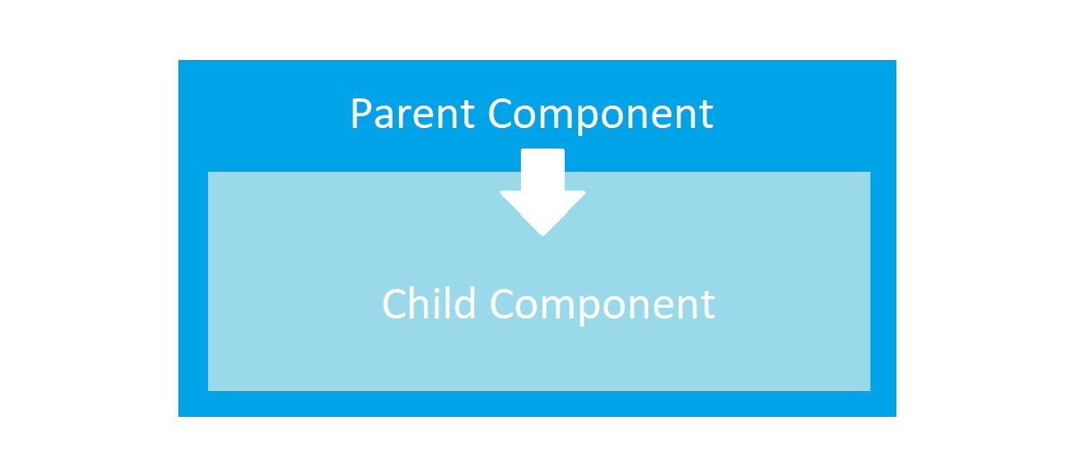
Angular js Child Component
Advantages of Components:
simpler configuration than plain directives
promote sane defaults and best practices
optimized for component-based architecture
writing component directives will make it easier to upgrade to Angular
Image Source: https://miro.medium.com/max/1400/1*_GApyQ-Q3A45KWl8ImbLbw.png
Notes:
Continuing from the last slide:
Title - Subtopic
Subtitle - Subtopic of Subtopic
Body - Description

Slide 33
Angular js Child Component
When not to use Components:
For directives that need to perform actions in compile and pre-link functions, because they aren't available
when you need advanced directive definition options like priority, terminal, multi-element
when you want a directive that is triggered by an attribute or CSS class, rather than an element
Image Source: https://miro.medium.com/max/1400/1*_GApyQ-Q3A45KWl8ImbLbw.png
Notes:
Continuing from the last slide:
Title - Subtopic
Subtitle - Subtopic of Subtopic
Body - Description

Slide 34
Angular js Child Component
Creating and configuring a Component
Components can be registered using the .component() method of an AngularJS module (returned by angular.module()).
Image Source: https://miro.medium.com/max/1400/1*_GApyQ-Q3A45KWl8ImbLbw.png
Notes:
Continuing from the last slide:
Title - Subtopic
Subtitle - Subtopic of Subtopic
Body - Description

Slide 35
Angular js Child Component
Component-based application architecture
Components have a well-defined public API - Inputs and Outputs:
However, scope isolation only goes so far, because AngularJS uses two-way binding.
So if you pass an object to a component like this - bindings: {item: '='}, and modify one of its properties, the change will be reflected in the parent component.
Image Source: https://miro.medium.com/max/1400/1*_GApyQ-Q3A45KWl8ImbLbw.png
Notes:
Continuing from the last slide:
Title - Subtopic
Subtitle - Subtopic of Subtopic
Body - Description

Slide 36
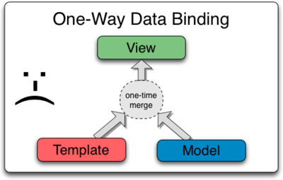
Angular js Data Binding, Event Binding,2 Way Binding
Angular js Data Binding
Components have a well-defined public API - Inputs and Outputs:
However, scope isolation only goes so far, because AngularJS uses two-way binding.
So if you pass an object to a component like this - bindings: {item: '='}, and modify one of its properties, the change will be reflected in the parent component.
Image Source:https://docs.angularjs.org/img/One_Way_Data_Binding.png
Notes:
Continuing from the last slide:
Title - Subtopic
Subtitle - Subtopic of Subtopic
Body - Description

Slide 37

Angular js Data Binding, Event Binding,2 Way Binding
How To Bind Events In AngularJS
We want the user to be able to take an action, and cause something to happen on the page.
Users will enter text into input boxes, pick items from lists and click buttons.
These types of user actions result in a flow of data from an element to a component.
Image Source:https://vegibit.com/wp-content/uploads/2018/11/How-To-Bind-Events-In-AngularJS.png
Notes:
Continuing from the last slide:
Title - Subtopic
Subtitle - Subtopic of Subtopic
Body - Description

Slide 38
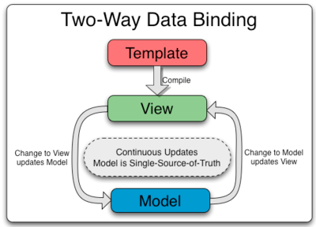
Angular js Data Binding, Event Binding,2 Way Binding
Two Way Data Binding
Two-way binding gives components in your application a way to share data.
Use two-way binding to listen for events and update values simultaneously between parent and child components.
Image Source:https://www.javatpoint.com/js/angularjs/images/two-way-data-binding.png
Notes:
Continuing from the last slide:
Title - Subtopic
Subtitle - Subtopic of Subtopic
Body - Description

